Slide 1
Week 2 Presentation
Group 1:
Jibin Mathews Maritza Torres

Slide 2
Objective
Make a course for the Lab 1 Group that is heavy on sensing and signaling.
Rover must complete the course in 60 seconds
Track Position of Rover and Determine speed required to finish on time
Course communication for various actions
IR and Sound

Slide 3
Deliverables
Lab Safety Training
Acquire Access to Lab
Raspberry Pi

Slide 4
Track Elements
Utilize Metallic Strip as path for rover to follow
Use IR Sensor and Sound Communication to Decode/ Encode Information with Rover
Track Rovers location

Slide 5
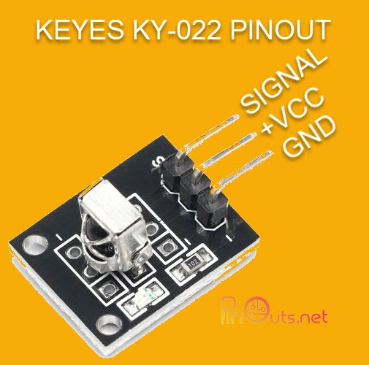
IR Receiver Module
Specs.:
Reception Distance: ~17m
Carrier Frequency: 38kHz
Can take 3.3V or 5V Power
Mounting
This will mount on a IR controlled servo to be facing the Rover at any given point on track
Can it be in the middle of the track?
(Pinouts, 2020)

Slide 6
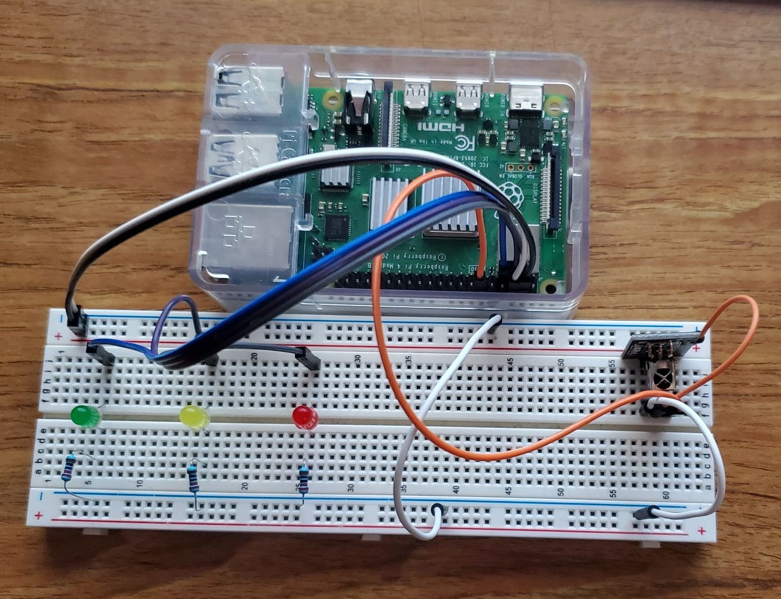
Circuitry for IR Receiver

Slide 7
Budget
Budget Lab 2 Project | Cost: | Total Spent:
Raspberry Pi 4 Model B | $129.99 | $0.00 |  | Material Costs | Cost: | Total Spent:
IR Receiver Module | $7.40 | $7.40 |  |  | $142.39 | $12.40
Misc. (LED, Resistors, Jumper wires) | $5.00 | $5.00
 |  |  |  | Totals | Total Cost: | Actual Cost:
 |  |  |  |  | $142.39 | $12.40

Slide 8
Gantt Chart
Lab 2 | Week 1 | Week 2 | Week 3 | Week 4 | Week 5 | Week 6 | Week 7
Hardware
Research
Path
Sensors
IR Receiver/ Transmitter
Speaker/ Microphone
Object Tracking w/ Camera
Software
Research
Download/ Install: Python/ Open CV
Actual Coding

Slide 9
Next Week's Deliverables
IR Receiver and Transmitter Completed
Implement Microphone/ Speaker Communication

Slide 10
References
Pinouts, F. (2020, April 7). Infrared sensor receiver module guide (KY-022). PinOuts.net - Electronic Components PinOuts. Retrieved June 21, 2022, from https://pinouts.net/infrared-sensor-receiver-module-guide-ky-022/
Lime-Parallelogram. (n.d.). IR Decoder. GitHub. Retrieved June 21, 2022, from https://github.com/Lime-Parallelogram/pyIR
Popov, D. (n.d.). Raspberry Pi IR Remote. Raspberry Pi Geek. Retrieved June 21, 2022, from https://www.raspberry-pi-geek.com/Archive/2015/10/Raspberry-Pi-IR-remote
Lime Parallelogram. (2019, September 11). Using an IR receiver on a Raspberry Pi (python tutorial). YouTube. Retrieved June 21, 2022, from https://www.youtube.com/watch?v=KhiqINyHx08&ab_channel=LimeParallelogram
Control an LED with Raspberry Pi 4 and Python 3 . The Robotics BackEnd. (2021, December 30). Retrieved June 21, 2022, from https://roboticsbackend.com/raspberry-pi-control-led-python-3/

Slide 11
Questions
?

